Slide 1
British Airways Reviews Analysis
11/1/2025

Slide 2
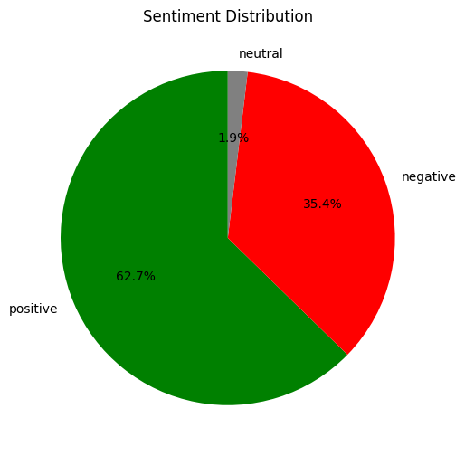
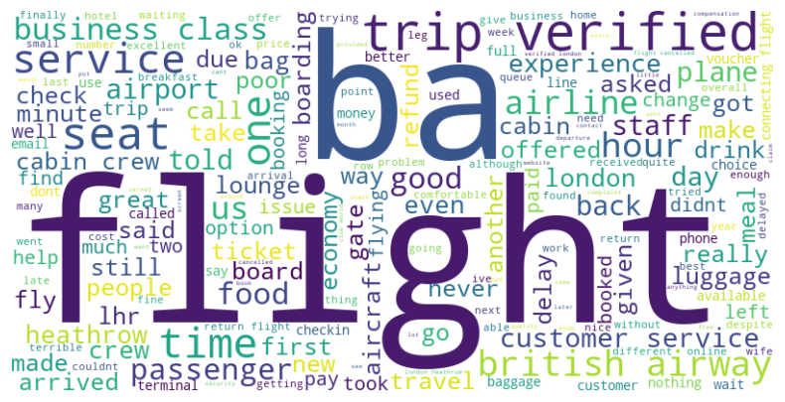
Results
Top key words and topics:
“flight cancellation”, “time”,“cabin service”, “food and drink”, ”boarding”, “luggage”.
Out of 1000 reviews, 62.7% of them are positive, 35.4% of them are negative

